Slide 1

Extracting Vitals from Smartphone Accelerometer
I set out to detect heart rate and respiration using only a smartphone accelerometer. I conducted controlled breathing and spontaneous breathing experiments (2s, 4s, 8s cycles).

Slide 2
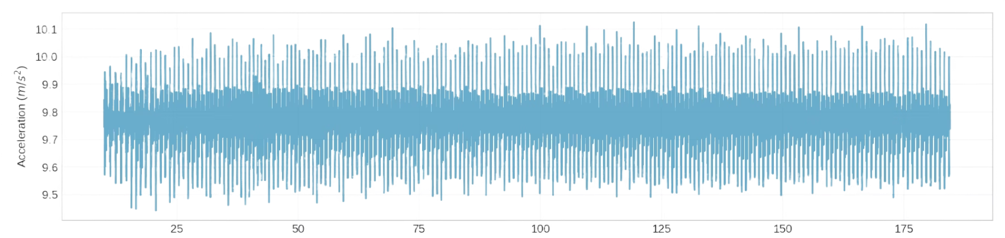
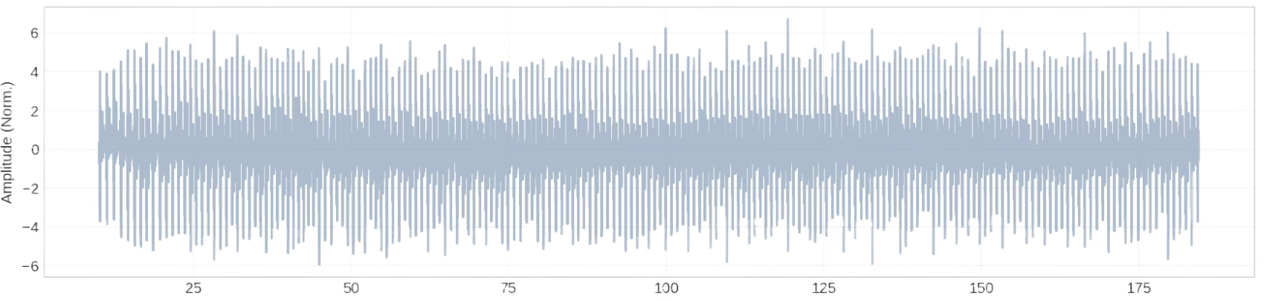
Data from an accelerometer is messy
Raw Z-axis Data
The raw signal is dominated by gravity, sitting at 9.8.
1
Processed Signal
Detrend (Remove Gravity).
PCA (Combine Axes into Max Variance direction).
Bandpass Filter (Isolate Frequencies).
2

Slide 3
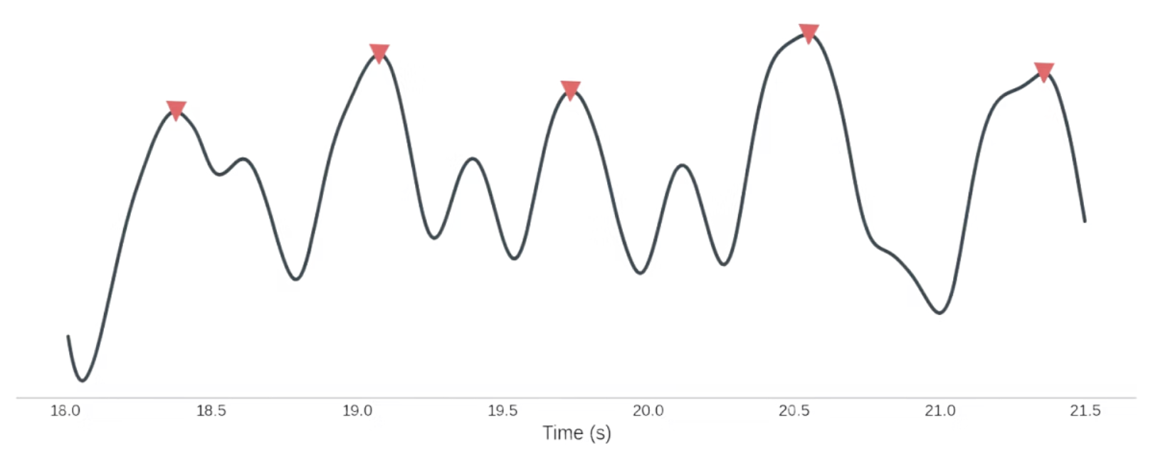
The Standard Pipeline (Time Domain)
The Goal: Identify local maxima (peaks) as heartbeats.
The Math: Calculate the time difference between peaks to derive instantaneous Heart Rate.
The Assumption: "If we filter the signal well, every peak is a heartbeat."
The Reality: "Unfortunately, real-world data isn't this clean..."

Slide 4

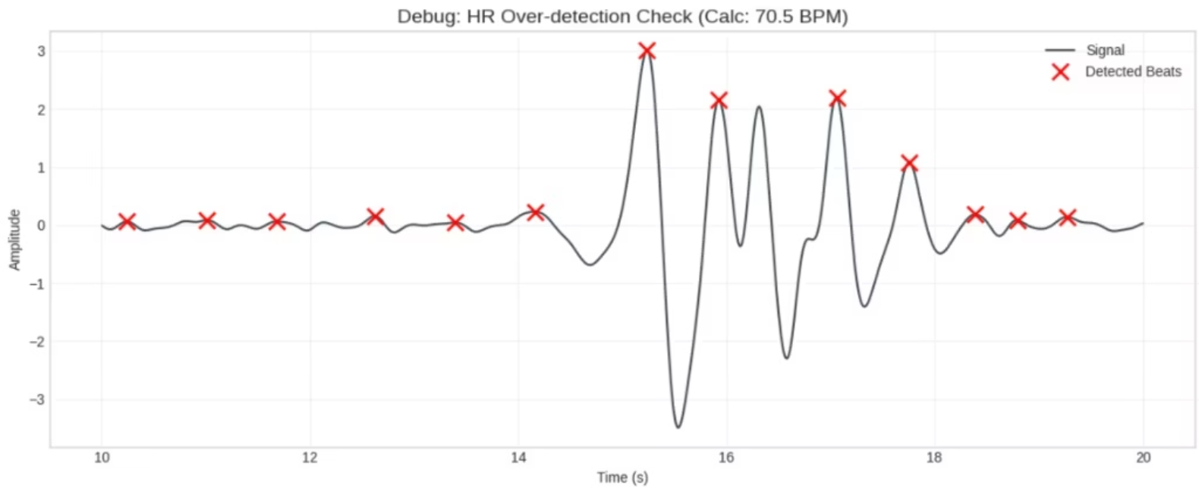
The Limitations of Static Thresholds
Method: Standard peak detection with fixed amplitude.
Failure: Motion artifacts are miscounted as heartbeats.
Result: Massive over-estimation of Heart Rate.

Slide 5

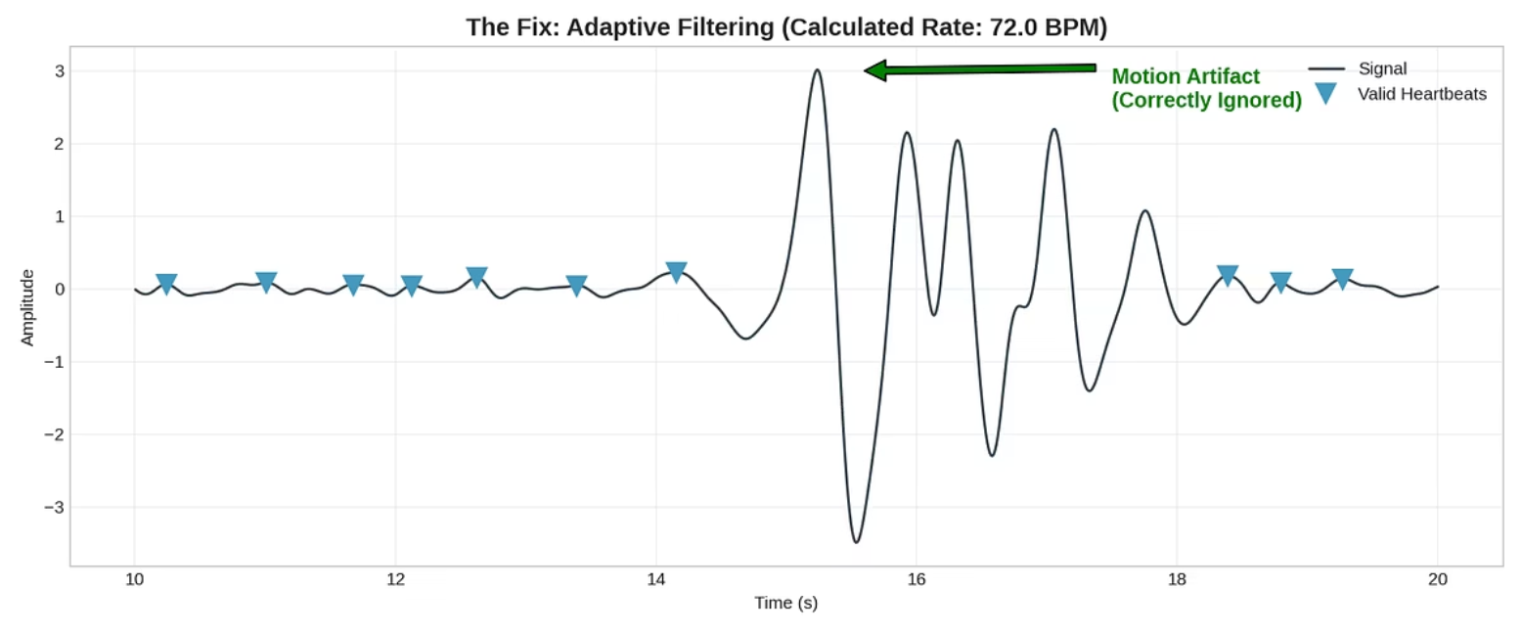
The Fix: Dynamic Thresholding
Median-Based Rejection: I switched to Median filtering to calculate the "typical" heartbeat height, ignoring massive motion spikes.
Physiological Constraints: I implemented a Minimum Peak Distance. The algorithm now "knows" that a heart cannot physically beat twice in 0.2 seconds, preventing double-counting.

Slide 6

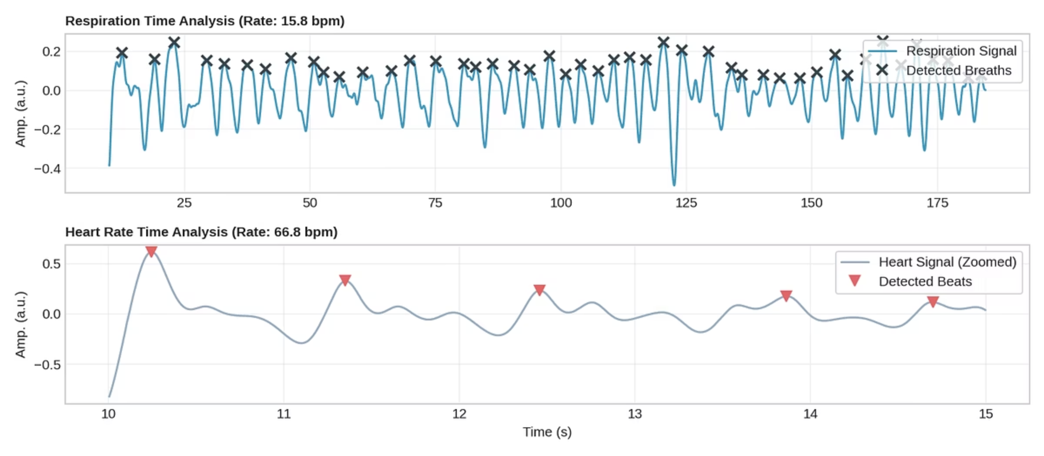
Final Vitals Extraction

Slide 7

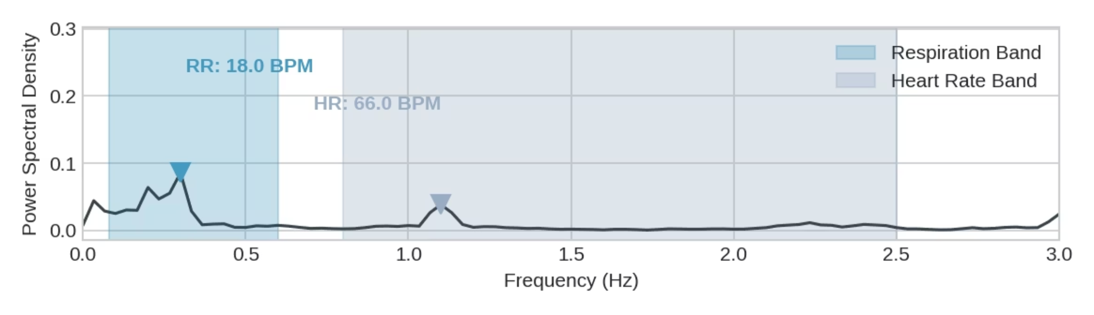
The Robust Solution: Welch's Periodogram
Switching to Frequency Domain analysis, specifically Welch's method, provided a breakthrough. This technique focuses on identifying dominant, repeating patterns across the entire signal rather than isolated spikes.

Slide 8

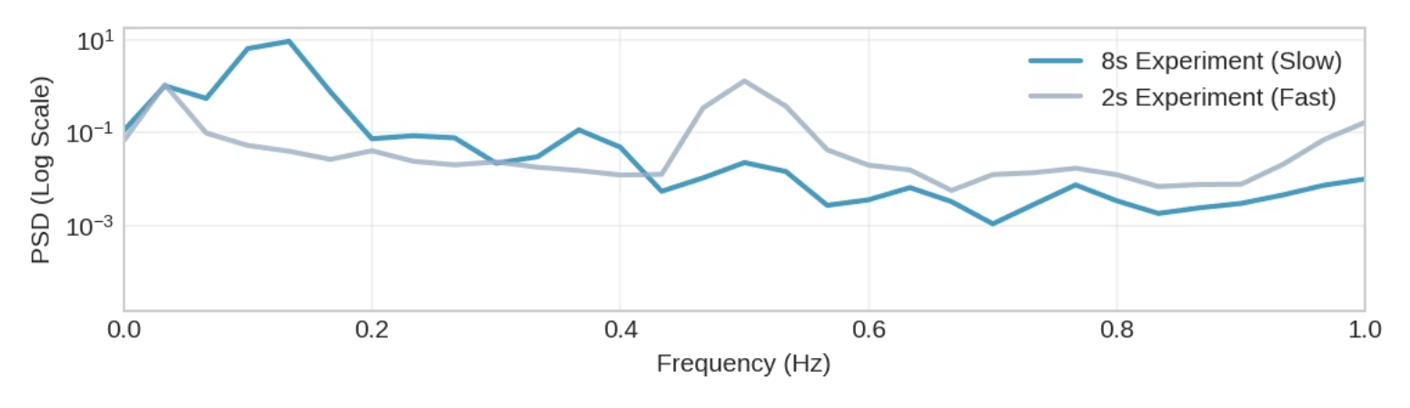
Proof of Robustness: Controlled Breathing Experiments
To prove this wasn't a fluke, I compared my 'Fast Breathing' (2s) experiment against my 'Slow Breathing' (8s) experiment.
Slow Breathing (8s cycle)
Fast Breathing (2s cycle)
The blue line clearly shows a peak at approximately 0.125 Hz, corresponding precisely to the 8-second breathing cycle (1/8 Hz).
The grey line demonstrates a distinct peak at 0.5 Hz, aligning perfectly with the 2-second breathing cycle (1/2 Hz).
The precise alignment of these peaks with the expected frequencies proves that the algorithm accurately and reliably fulfils its purpose.

Slide 9

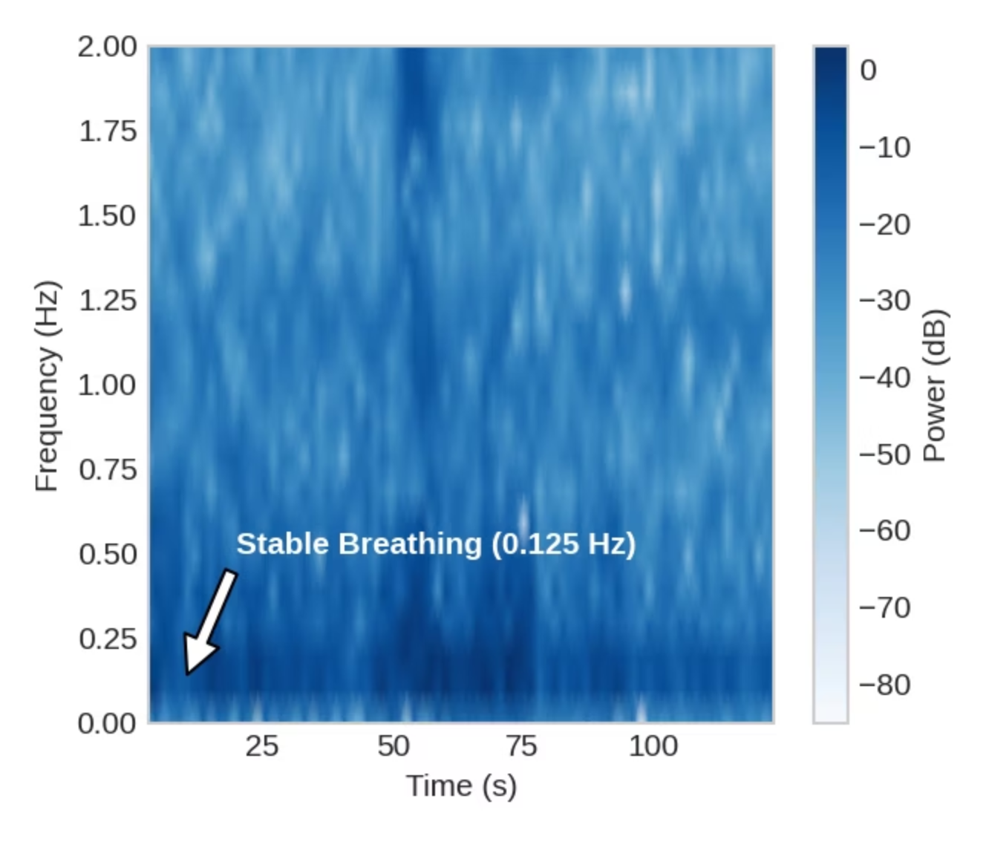
Visualising Stability: The Spectrogram
Unbroken Horizontal Line: The spectrogram displays a consistent, continuous high-energy band across the entire 2-minute recording.
Experimental Control: This visually confirms that the breathing rate did not drift or fluctuate, validating the quality of the controlled experiment.

Slide 10

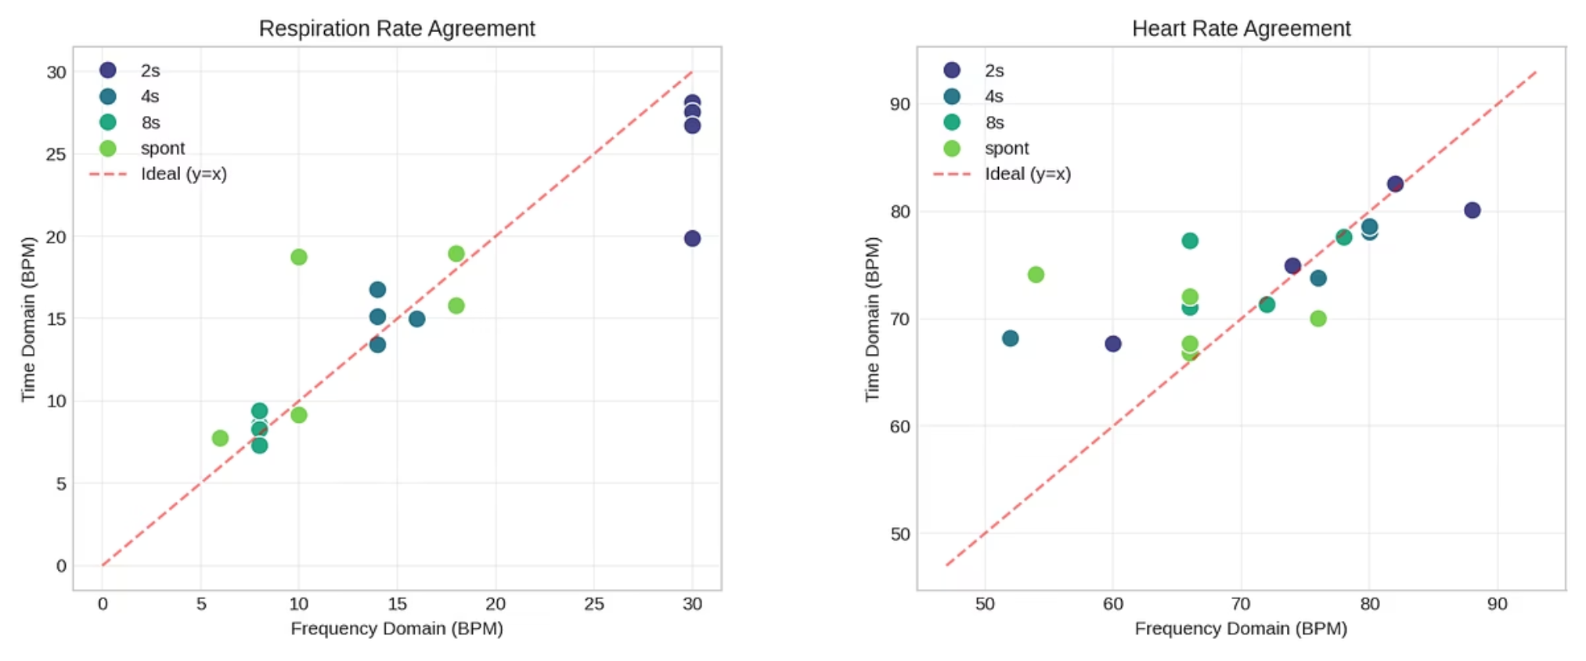
Validation: Method Agreement
General Trend: Both methods successfully distinguish between Resting and Active states.
Heart Rate Bias: Time Domain is slightly higher. Likely caused by residual false positives from noise artifacts increasing the count.
Respiration Bias: Time Domain is lower during fast breathing. Shallow breaths sometimes fall below the detection threshold (false negatives). Even with dynamic thresholds some human intervention seems to be still necessary to adjust their parameters to ensure accuracy.

Slide 11

Conclusion: Key Takeaways
Frequency Domain is excellent for average rates (Stable)
Time Domain is viable if adaptive thresholds are used.
Future Work: Real-time implementation would require a sliding window to minimize lag vs. accuracy trade-offs.

